Slide 1
Defensive Solution Project on VSI
By: Hassan Evans, Drew Dickenson, Camron Neal, Harshini Lanka

Slide 2
Monitoring Environment
We are monitoring solutions to protect the VSI. There is a rumor that JobeCorp may lauch cyberattacks to disrupt VSI business. We went through logs and found where the attacks came from and we also have future mitigations to make sure these attacks don’t happen again.

Slide 3
Splunk App Add-On Unix and Linux
The Splunk Add-on for Unix and Linux enables collection, parsing, and normalization of logs and system metrics from Unix and Linux servers for better monitoring and analysis in Splunk.

Slide 4
Windows Logs
Report Name | Report of Description
Status Window Log | Shows the comparison for the success and failure of window activities
Signature ID's Window Log | Table of signature id's ex.(An account was sucessfully logged on, A user account was changed, A user account was locked.)
Severity Levels Window logs | Informational means no action needed, general information and High means investigation or action needs to be taken

Slide 5
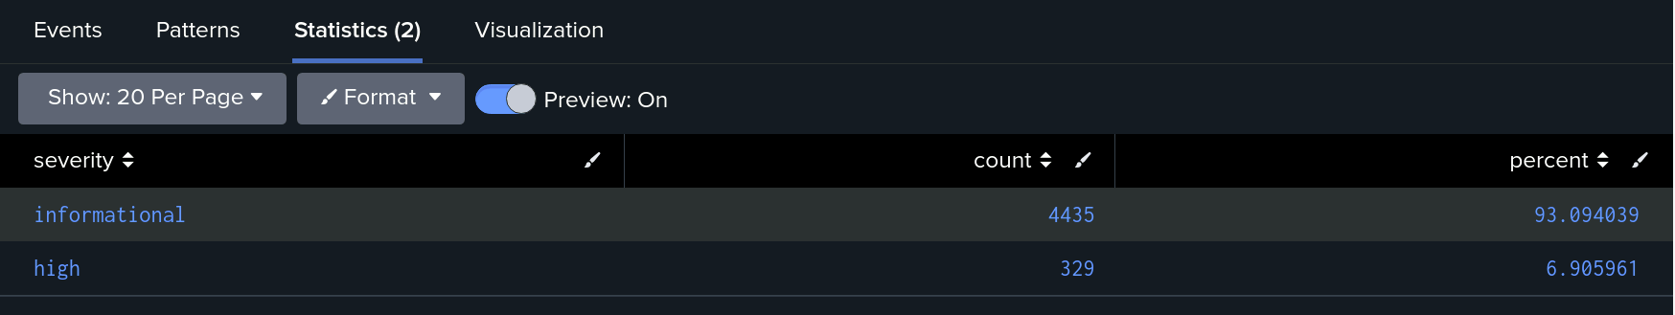
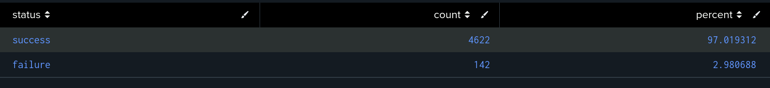
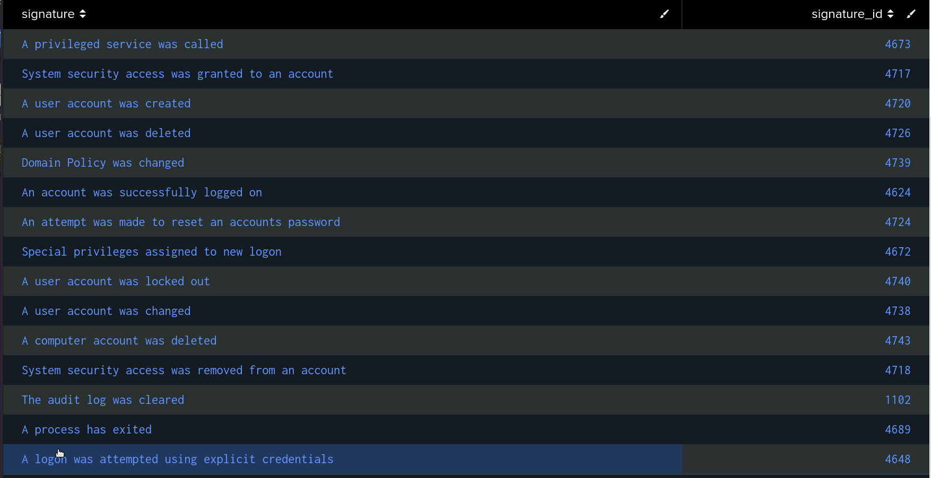
Window Log Report Images

Slide 6
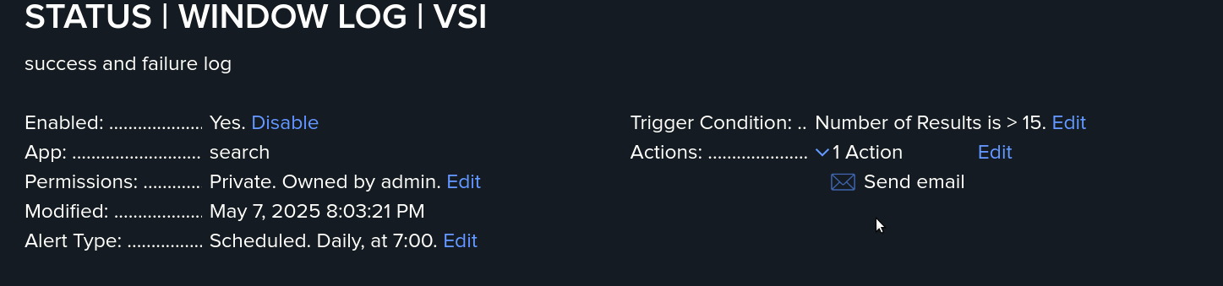
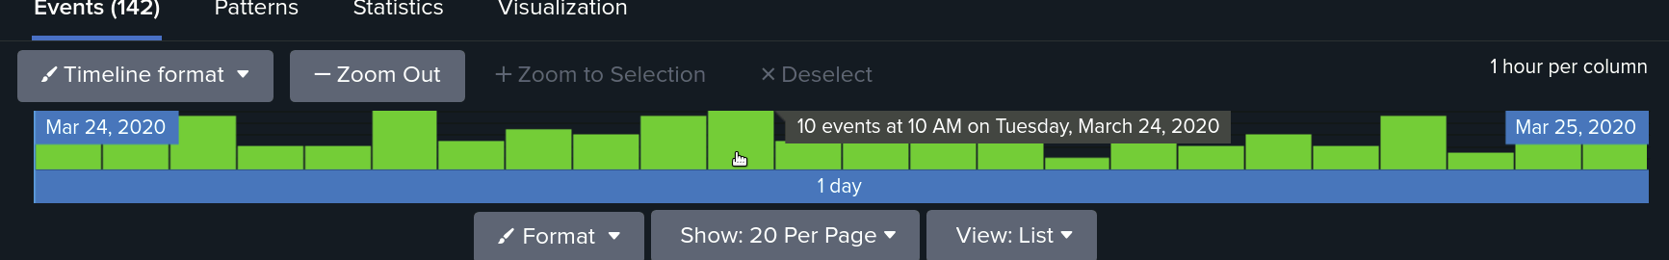
Alerts Windows Logs

Slide 7
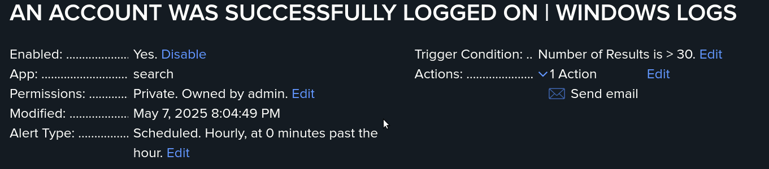
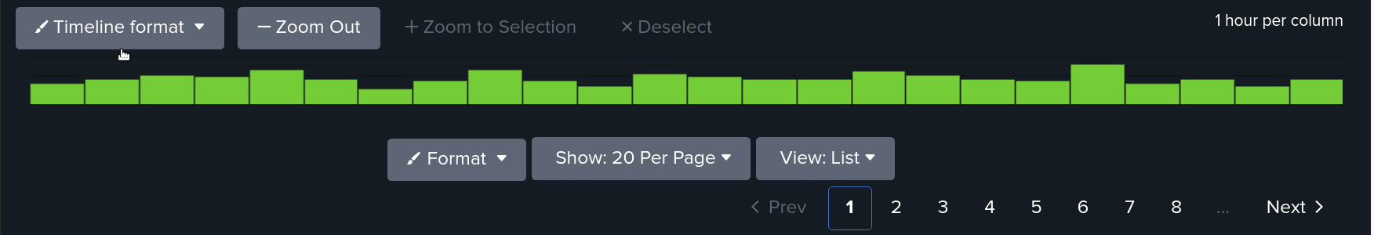
Alerts Window Logs

Slide 8
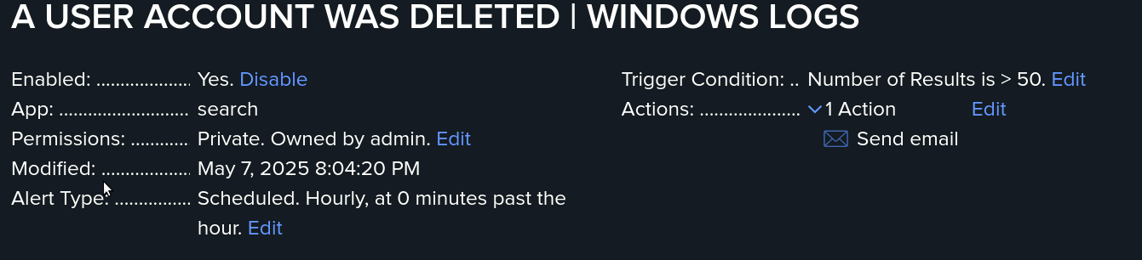
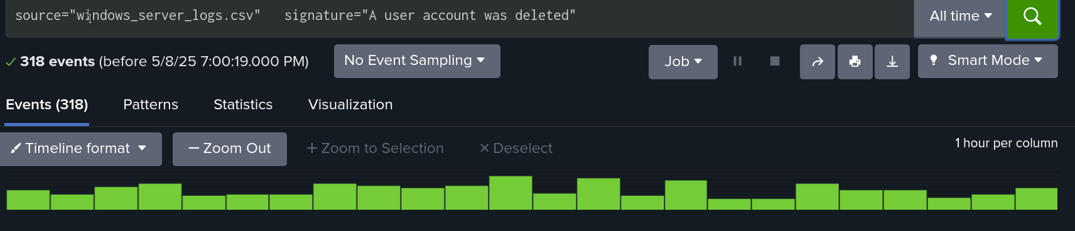
Alerts Window Logs

Slide 9
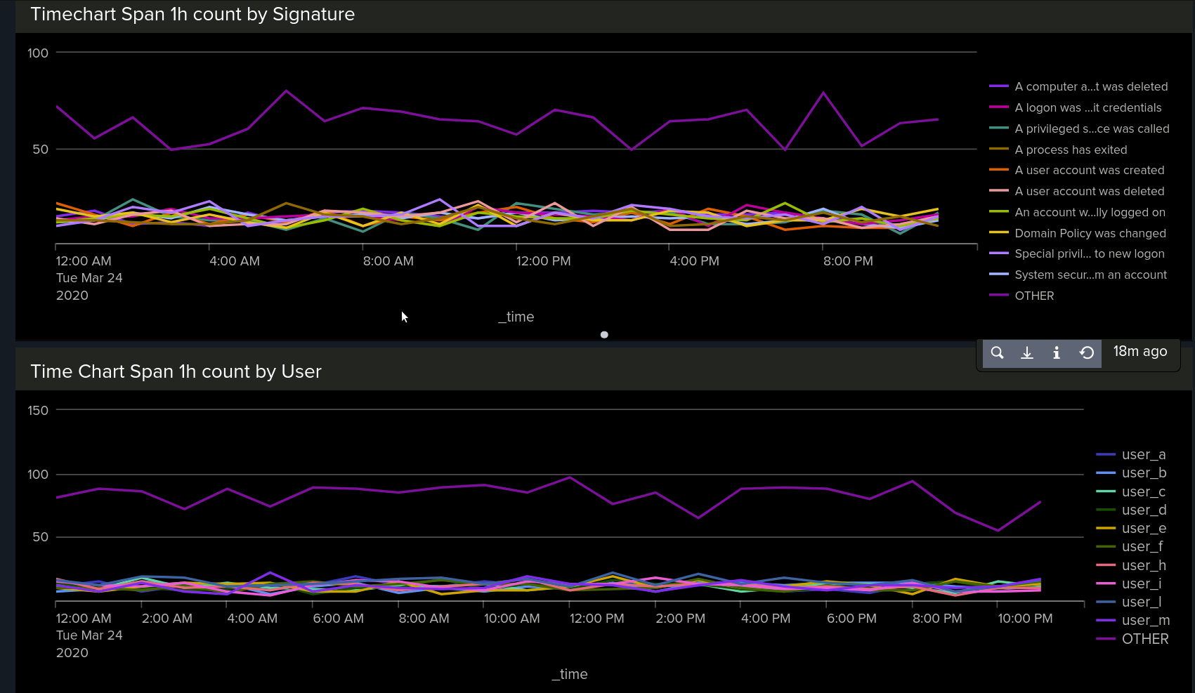
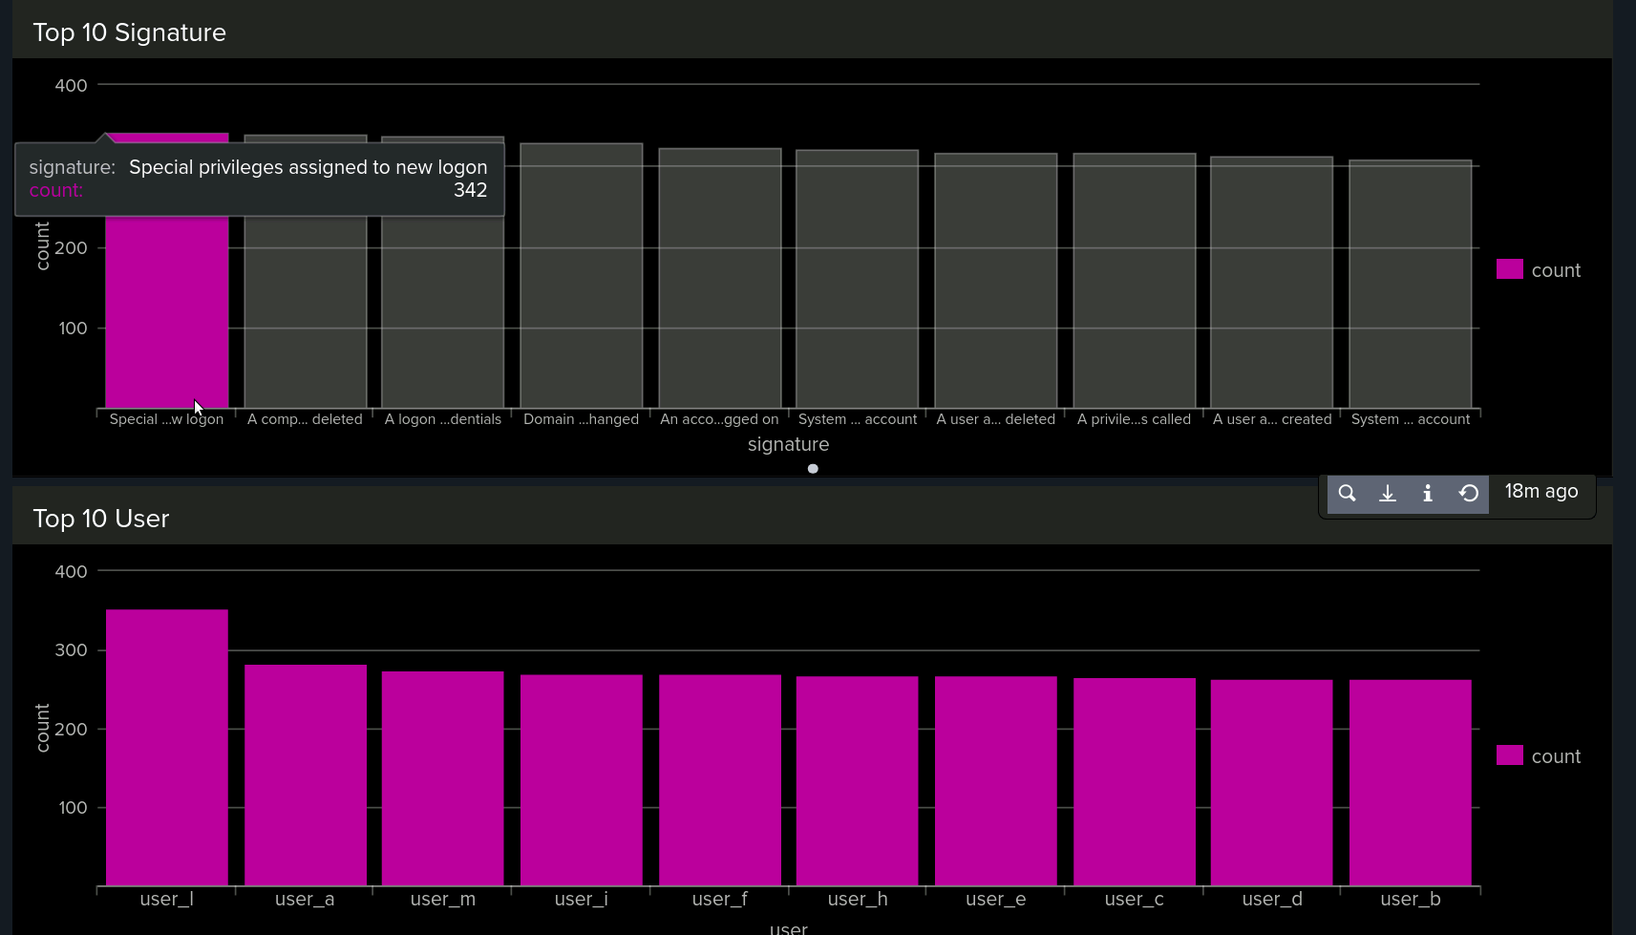
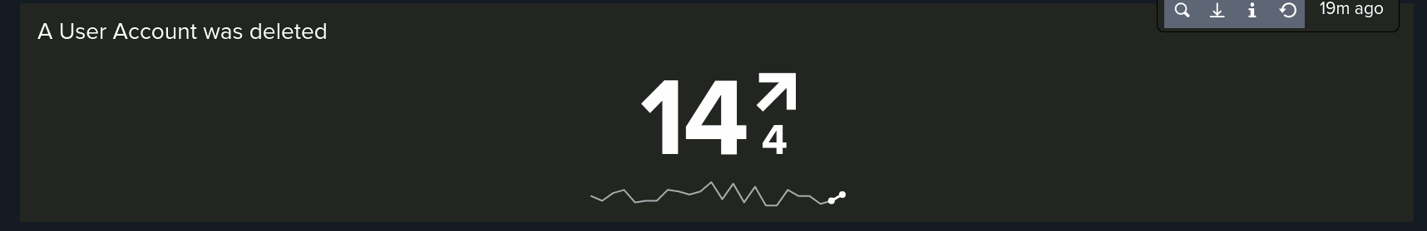
Dashboard Windows Logs

Slide 10
Apache Logs
Report Name | Report Description
Apache Logs Method | Table that shows the different HTTP methods (GET,POST, HEAD, ETC)
Apache Logs Domains | Domain shows the most visited websites
Apache Logs Response Code | A report that shows the count of each HTTP response code.

Slide 11
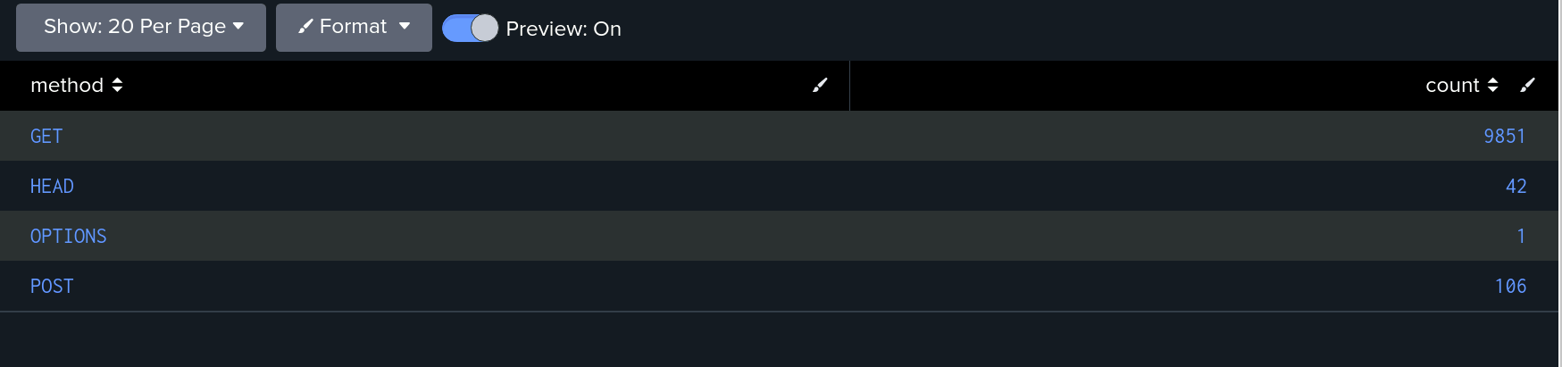
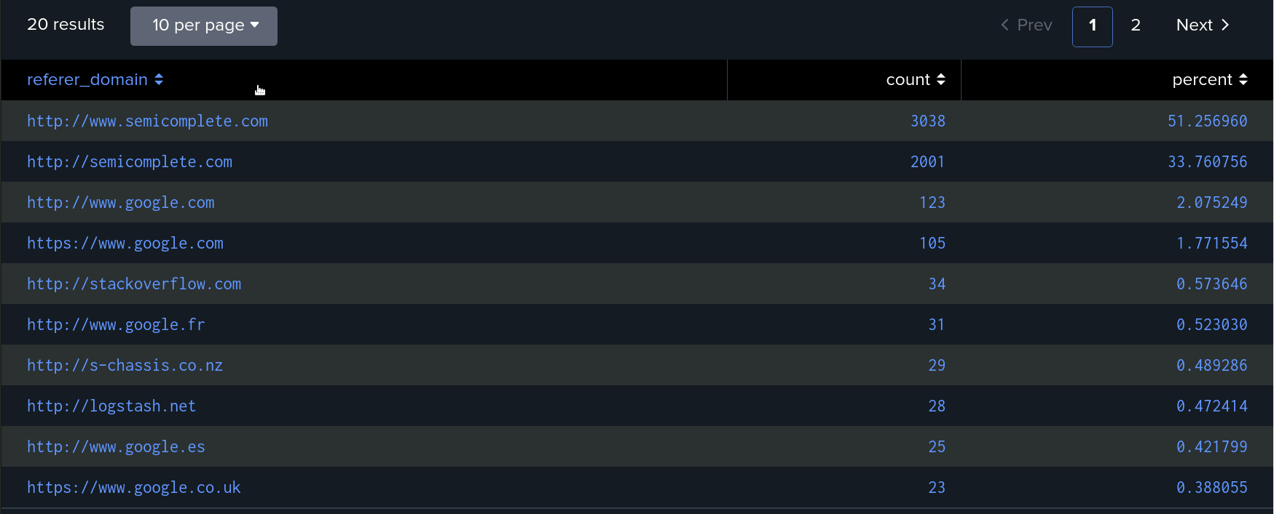
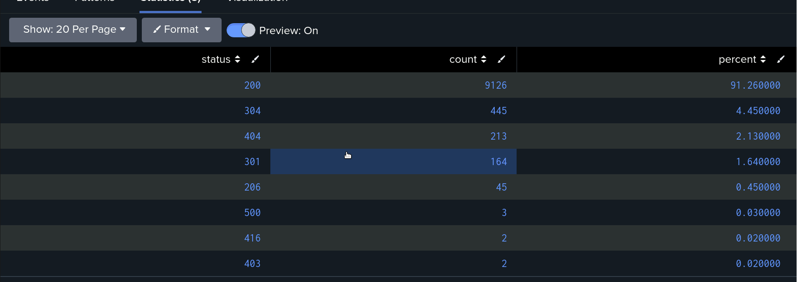
Apache Logs
Apache Logs Method
Apache Top Domains
Apache Top Status

Slide 12
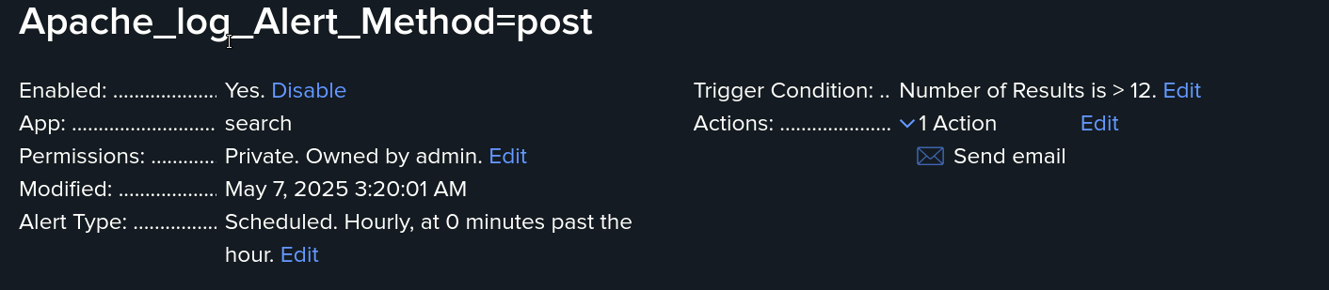
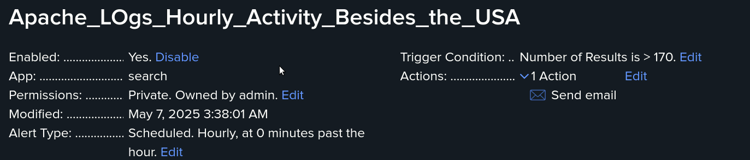
Apache Alerts

Slide 13
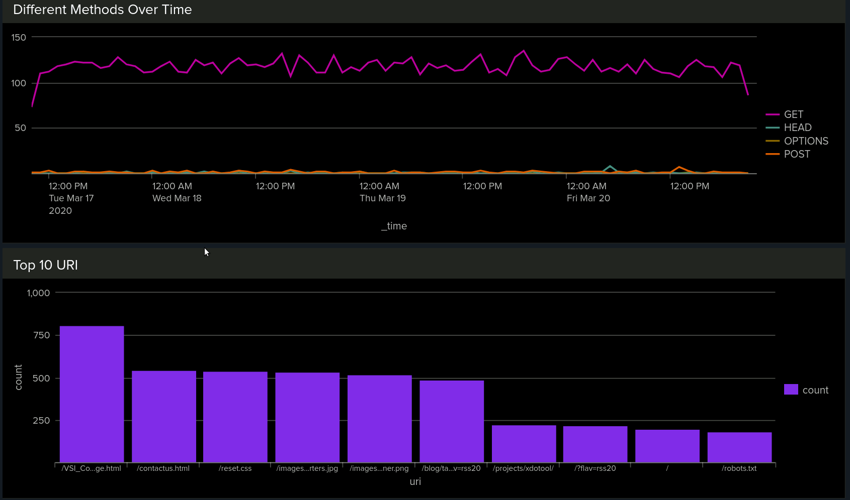
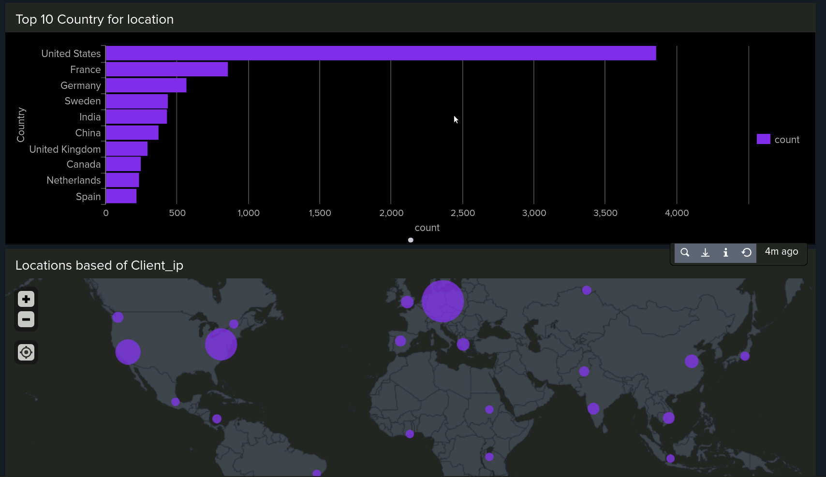
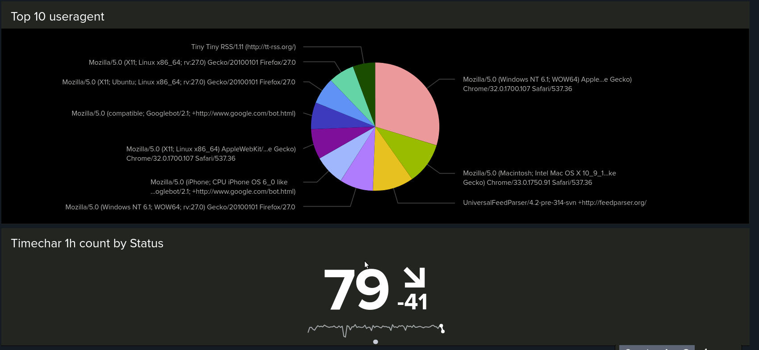
Apache Dashboard

Slide 14
Window Attack Logs Alert Summary
We had a spike in the attack logs at 8am on March 25,2020. The count was around 35 which would have been caught by our alert that we already have set up.
We observed an average baseline count of around 13–17, but we set our alert threshold at 50, since anything above that would likely indicate suspicious activity. The suspicious activity we found was around 11 a.m, with the count of 196 and 12p.m with the count of 77.
For user account was deleted we did not see any suspicious activity both logs looked similar with no suspected activity.

Slide 15
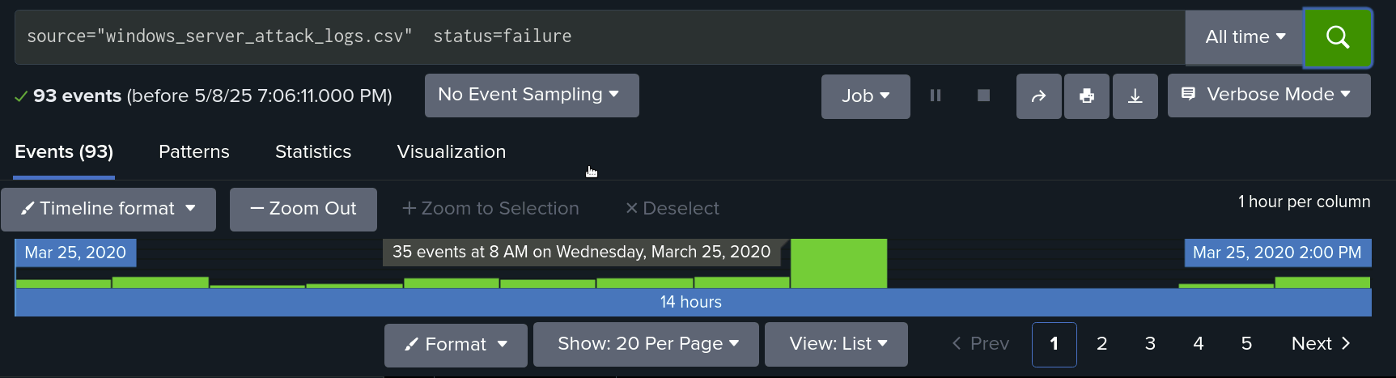
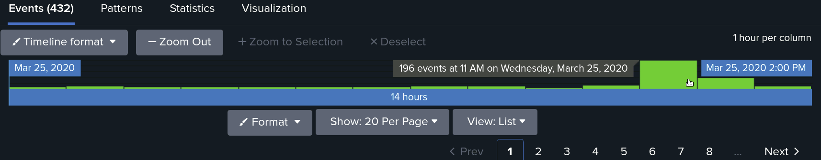
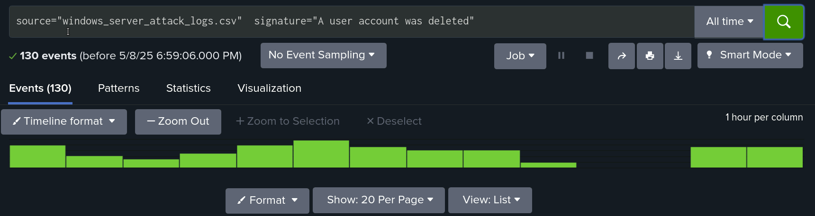
Window Attack log Images

Slide 16
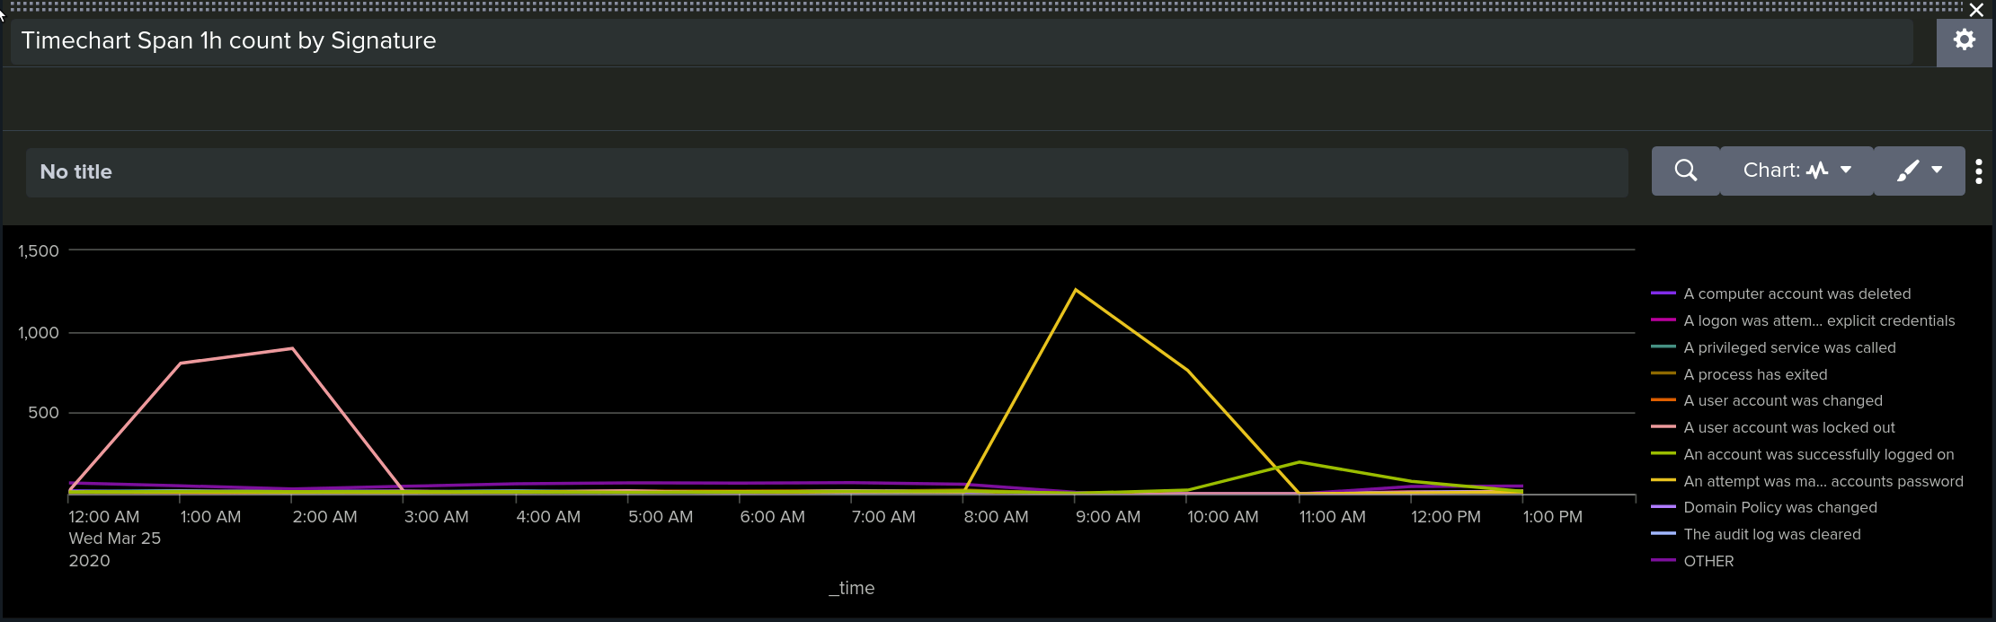
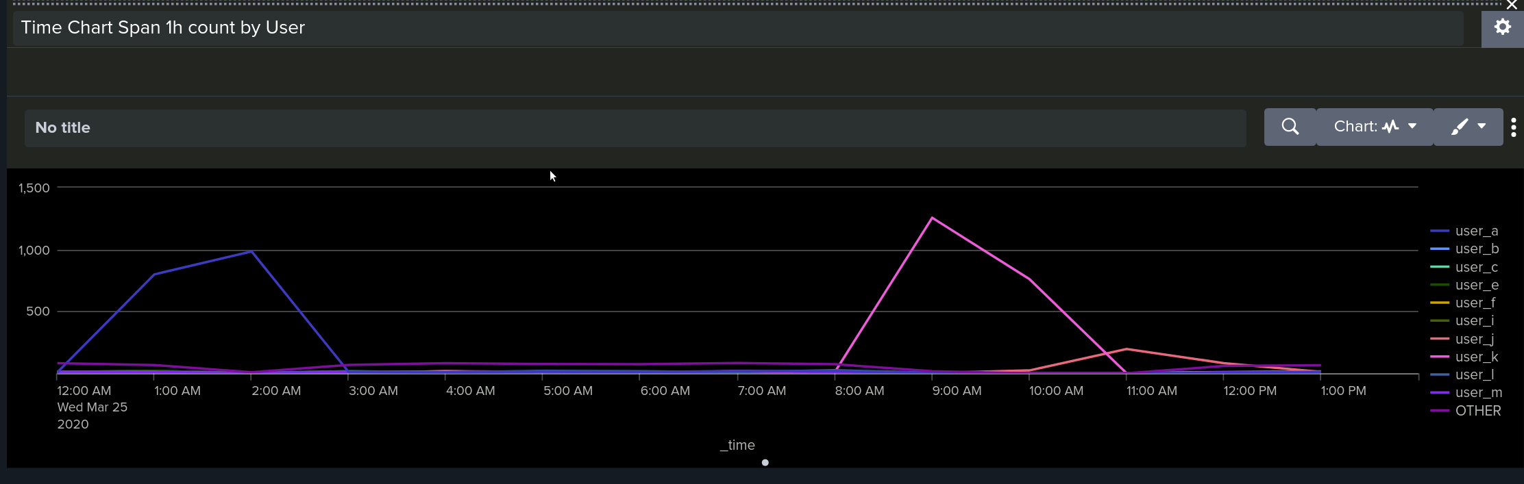
Dashboard analysis for User and Signatures from Attack Logs

Slide 17
Summary for User and Signature Dashboard Attack Log
Between midnight and 3 a.m., the most suspicious activity occurred, particularly at 1 a.m. and 2 a.m. The standout event was repeated "User Account is Locked out" alerts, which peaked at 896 occurrences. Additionally, from 8 a.m. to 11 a.m., there were attempts to reset an account password, peaking at 1,258 occurrences. These patterns suggest possible unauthorized access attempts during the early morning hours followed by password reset efforts later in the morning.
Users A and K both showed significant activity in the attack logs, with User K being more suspicious due to a higher event count. User A’s activity occurred between midnight and 3 a.m., peaking at 984 events, while User K’s activity took place from 8 a.m. to 11 a.m., with a peak of 1,256 events. These patterns align with the earlier timeline of account lockouts and password reset attempts, reinforcing suspicions of potential unauthorized access or malicious activity.

Slide 18
Apache Logs Before the Attack
Apache Logs Method
Apache Top Domains
Apache Top Status

Slide 19
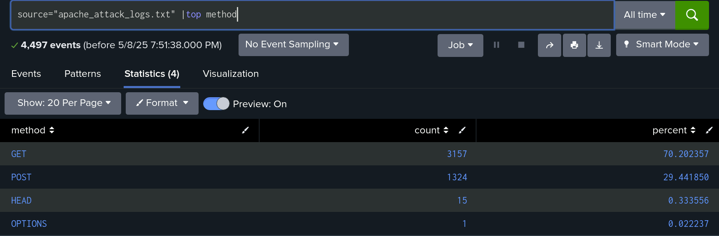
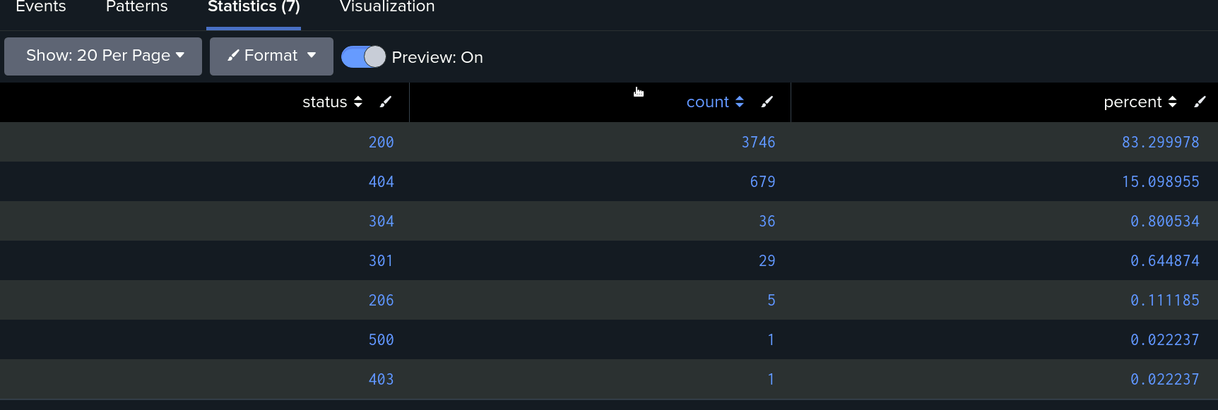
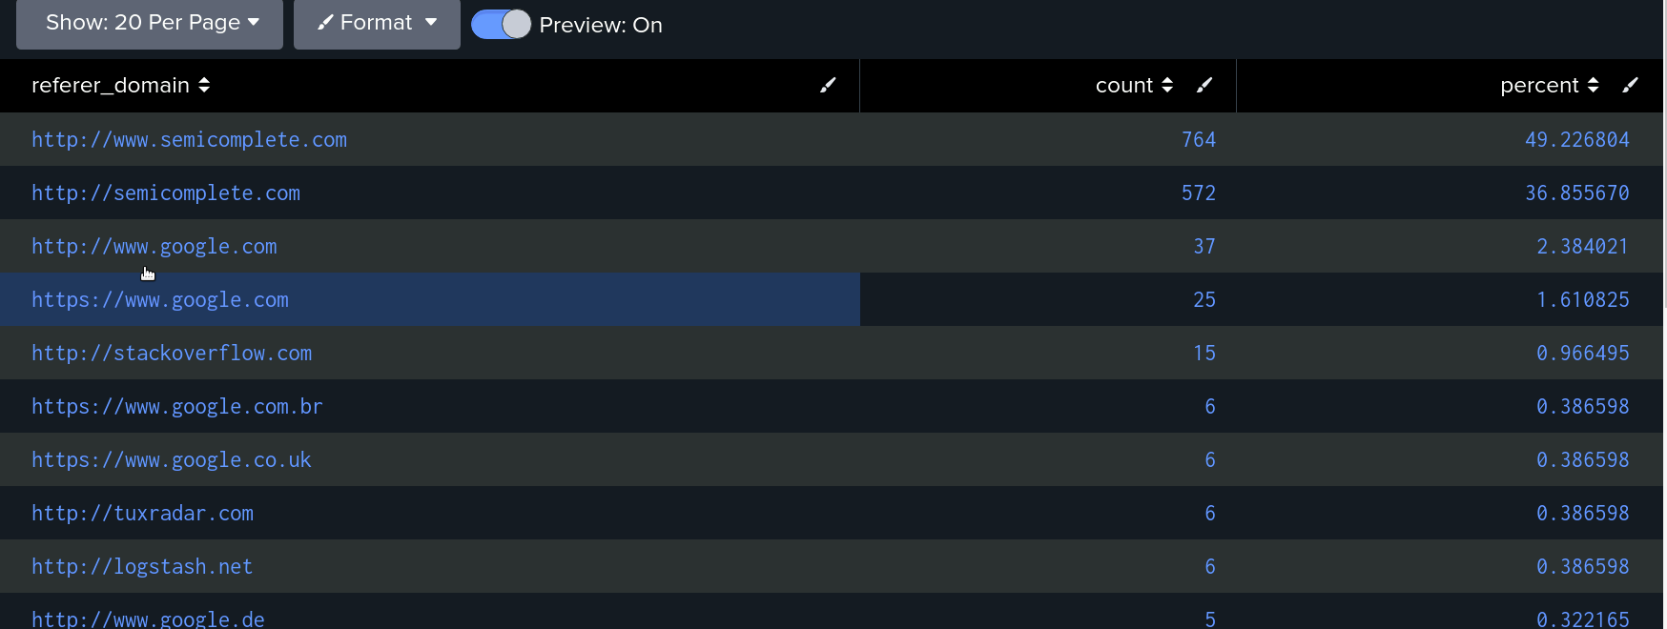
Apache Attack Log Images
Top status attack log
Top Domain

Slide 20
Apache Attack Log Summary
There was a suspicious decrease in the GET activity by 29% and we had an suspicious increase in the POST activity which increased by 29%
There were no suspicious activity when we pulled the referrer domains log.
We observed several minor changes to the top status apache attack log , but the most suspicious finding was the increase in 404 response codes, which jumped from 2% to 15%.
There are several small changes overall, but the most suspicious change detected was the 404 response code increasing from 2% to 1

Slide 21
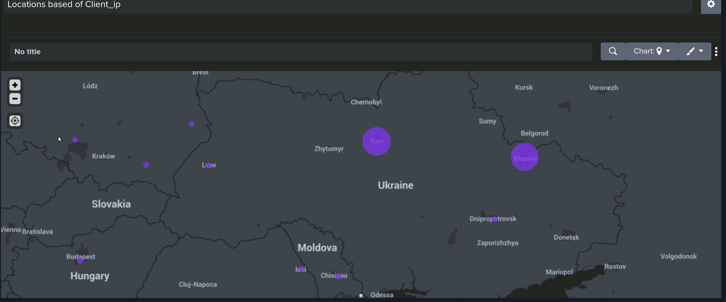
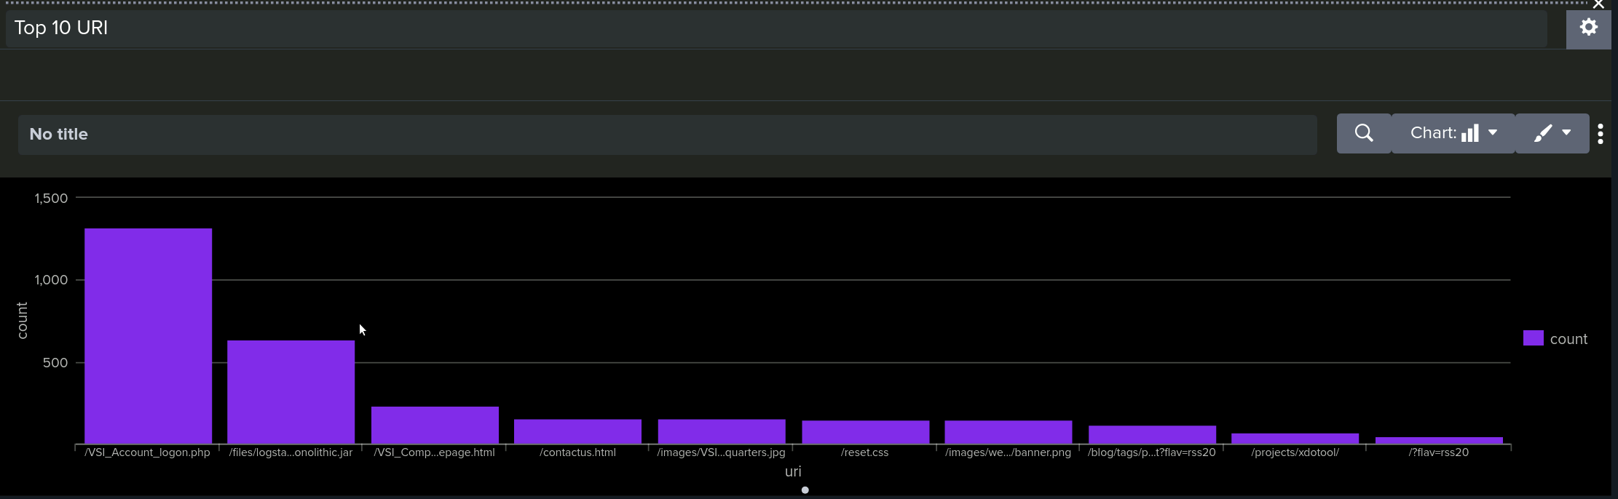
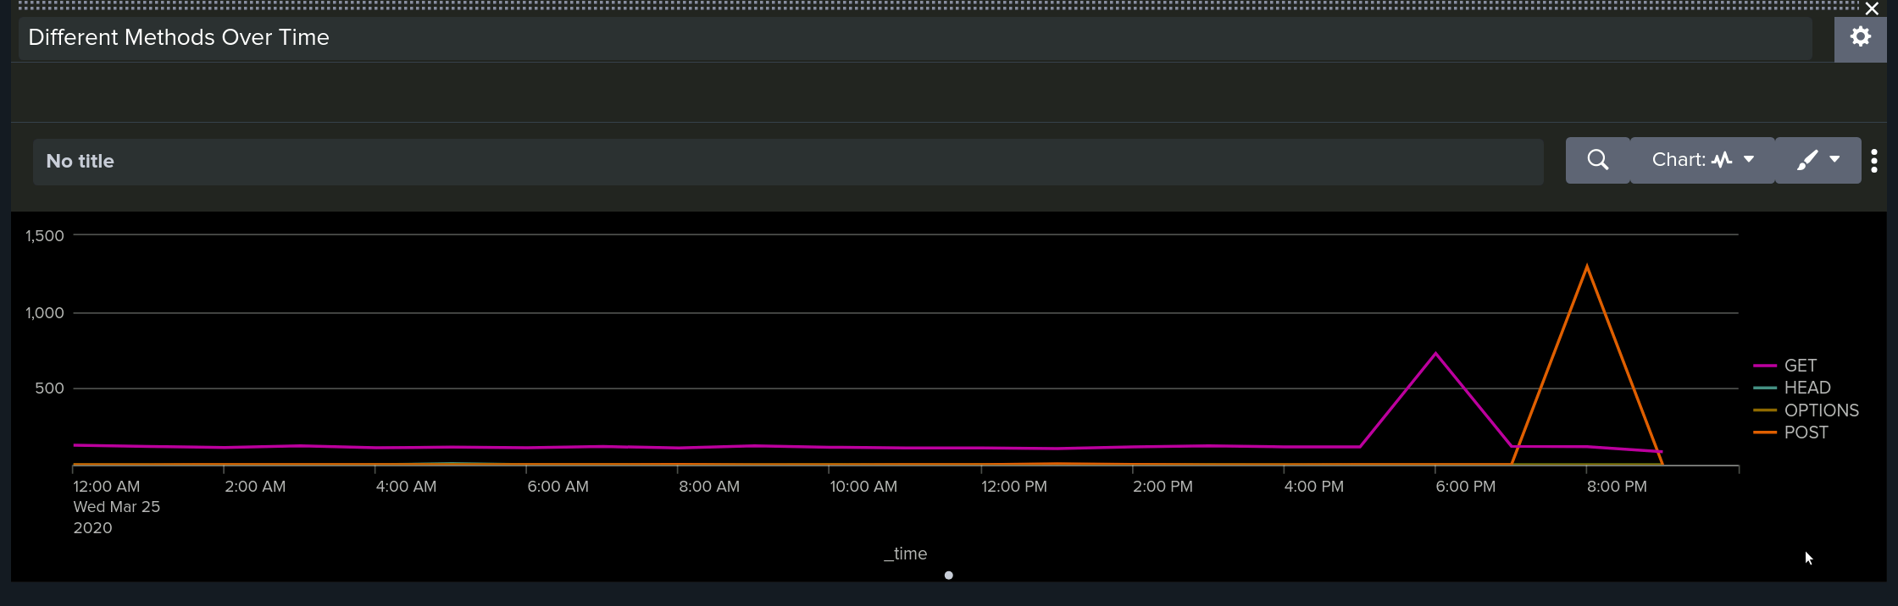
Apache Dashboard Attack Log Images

Slide 22
Apache Attack Log Summary
We observed a high volume of suspicious activity targeting the URI /VSI_Account_logon.php, which was hit 1,323 times.
The majority of this activity originated from two cities in Ukraine, with Kiev showing the highest activity followed by Kharkiv.
Additionally, there was a noticeable increase in HTTP POST methods between 7 a.m. and 9 a.m., aligning with the spike seen in the attack logs from Ukraine.
These patterns further support the likelihood of a brute-force attempt focused on the login endpoint.

Slide 23
Attack Mitigation Strategies
To protect VSI On Windows and Apache servers from future attacks, recommended future mitigations. ○Two-factor authentication, the first line of defense against Brute force attacks and brute force spamming passwords ○Lock users out after a certain number of login attempts to prevent attacks.
To protect VSI servers from the resetting of passwords and locked out accounts we can lower thresholds.
To mitigate any non US activity we can block IP's from certain high risk areas

